Slide 1
Homework Setup
Johannes Jablonski, Univ. Erlangen
ADAP A03
Licensed under CC BY 4.0 International

Slide 2
Agenda
ADAP Names
Repository setup
Submission
Further tips

Slide 3
ADAP Names
Mandatory homework for the first part of ADAP
Implement homogeneous names
Examples:
Domains: oss.cs.fau.de
File paths: /home/admin
component
oss
.
cs
.
fau
.
de
delimiter

Slide 4
Automated tests
Public tests
Are visible to you
Can be executed by yourself
Private tests
Are not visible to you
Cannot be executed by yourself

Slide 5
Setup homework repository (adap-names)
Remote setup
Fork the repository https://github.com/riehlegroup/adap-names
Ensure the repository is public and stays public
Local Setup
Clone your forked repository to your local machine
Install dependencies
Example
git clone https://github.com/<username>/adap-names
cd adap-names
npm install

Slide 6
Important files / directories
/src
Contains the files you need to edit for the homework
E.g., src/adap-b01/names/Name.ts
Only the work done in the respective subfolder is graded
⇒ Changes to any other files (e.g. package.json, tsconfig.json, test files) will NOT be reflected in grading and may result in failing tests
/test
Contains public test files
E.g., test/adap-b01/names/Name.test.ts

Slide 7
Test your implementation
Ensure that the project builds
npm run build
Run the public tests
npm run test # for all exercises
npm run test:b01 # for exercise B01
Check the results
Test Files 1 failed (1) Tests 3 failed | 1 passed (4)

Slide 8
Submission
Commit and push your submissions before the next lecture
Make sure your repository is up-to-date with the upstream repo
Your repository must be public
Only the default branch is graded
Late uploads are not graded
GitHub shows feedback for public tests (if you enable GitHub Actions)
This is just a preview and does not necessarily reflect your score
All tests (public and private) are run on our infrastructure
Our repository setup slightly differs from yours (→ Only change files in the src directory!)
Final feedback at the end of the semester

Slide 9
Send us your repository link
Fill out the following form until the start of the next lecture (2024-10-21, 13:00) https://forms.gle/Hu85W6VFrtJPp4kc8

Slide 10
Helpful resources
How to fork a repository https://docs.github.com/en/pull-requests/collaborating-with-pull-requests/working-with-forks/fork-a-repo
TypeScript for the New Programmer https://www.typescriptlang.org/docs/handbook/typescript-from-scratch.html
TypeScript for Java/C# Programmers https://www.typescriptlang.org/docs/handbook/typescript-in-5-minutes-oop.html
The TypeScript Handbook https://www.typescriptlang.org/docs/handbook/intro.html

Slide 11
Summary
ADAP Names
Repository setup
Submission
Further tips

Slide 12
Thank you! Any questions?
adap-team@group.riehle.org – https://oss.cs.fau.de

Slide 13
Legal Notices
License
Licensed under the CC BY 4.0 International license
Copyright
© 2024 Johannes Jablonski, some rights reserved

Slide 14
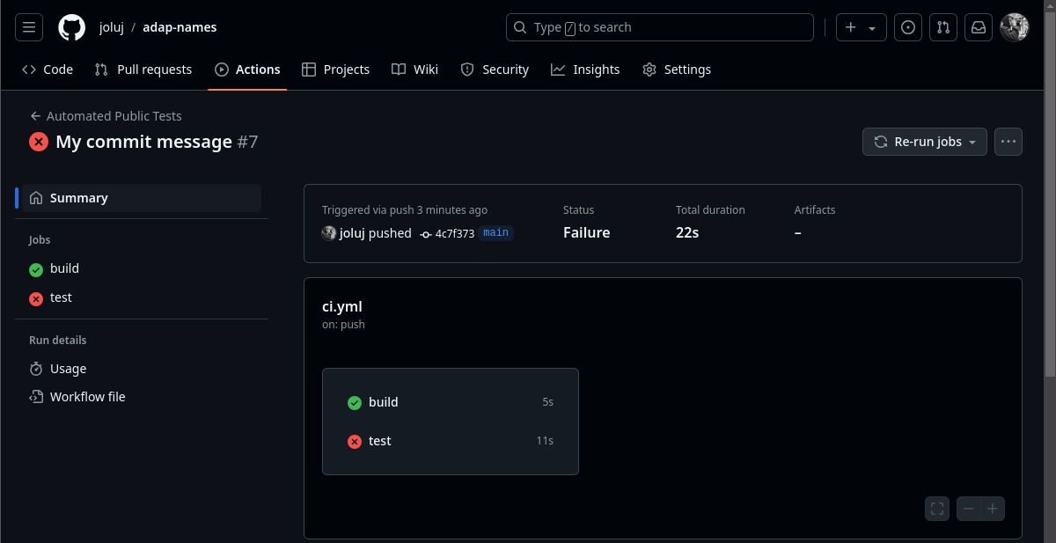
Public Feedback (1/3) - Overview

Slide 15
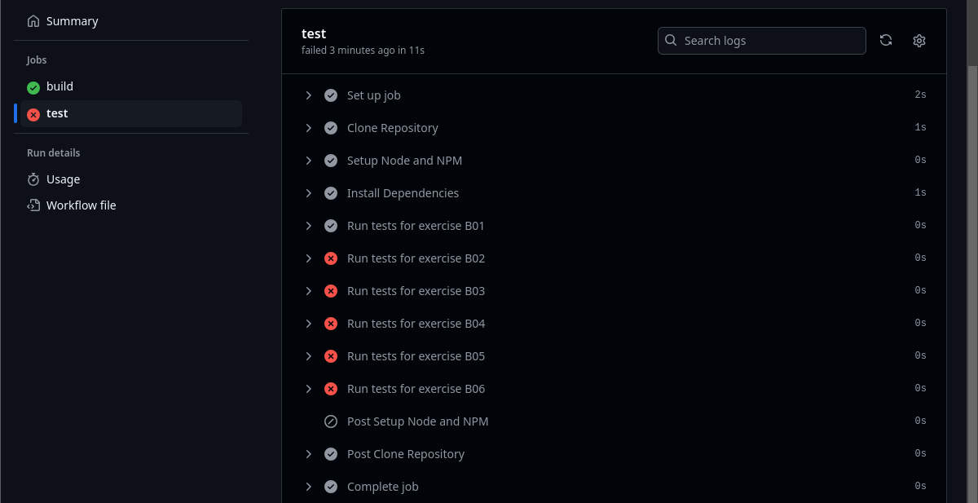
Public Feedback (2/3) - Public tests

Slide 16
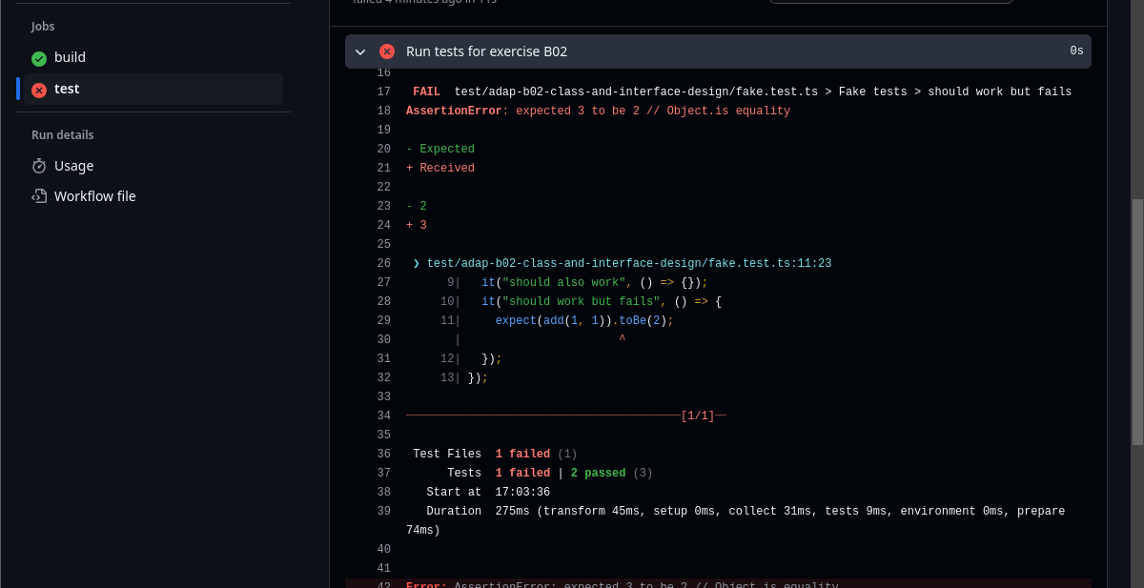
Public Feedback (3/3) - Inspect failed test

